Slide 1



learn invent impact
Control Path Model (CPM) for Loop Behaviors
Suresh C. Kothari
Professor, Department of Electrical and Computer Engineering
President & Founder EnSoft Corp.
Acknowledgement: Team members at Iowa State University and EnSoft, DARPA contracts FA8750-12-2-0126 & FA8750-15-2-0080

Slide 2
Loop Iterations
h: the loop header
b₁, b₂, … , b_{n}: the sequence of nodes inside the loop, no branch, just one behavior.
a: the predecessor, and c: the successor of the loop.
k: the number of iterations, k = 0 means the loop is skipped
a
The following are behaviors for k = 0, 1, 2
k = 0: a, h, c;
h
b₁
b₂
b₃
k = 1: a, h, b₁, b₂, b₃, h, c;
c
k = 2: a, h, b₁, b₂, b₃, h, b₁, b₂, b₃, c;
What is wrong ?

Slide 3
Loop Iterations with the possibility of break
B_{K}: BREAK
a
The following are behaviors for k = 0, 1, 2
k = 0: a, h, c;
h
b₁
b₂
b₃
k = 1: a, h, b₁, b₂, b₃, h, c;
c
B_{K}
k = 2: a, h, b₁, b₂, b₃, h, b₁, b₂, b₃, h, c;
At what node is the loop exited?
Additional behaviors due to break
The loop is exited at b₂.
k = 1: a, h, b₁, b₂, B_{K,} c;
k = 2: a, h, b₁, b₂, b₃, h, b₁, b₂, B_{K,} c;

Slide 4
Semantics of break
Semantics of BREAK: go to (jump) to the unique successor of the loop.
a
h
exit
b₁
b₂
b₃
successor
c
B_{K}
Between exit and the break there can be many statements – exception processing
break
break: jump to successor

Slide 5
What should a loop model be?
Analyzing arbitrary loops is known to be an impossible problem (e.g., the halting problem is not solvable)
Requirements for a practical loop model:
The model must define constraints on loops
The constraints should allow for loop features used in real-world software
The model should be an abstraction that works for all programming languages
The abstraction should enable efficient and accurate analyses of loops
model cannot be for all loops

Slide 6
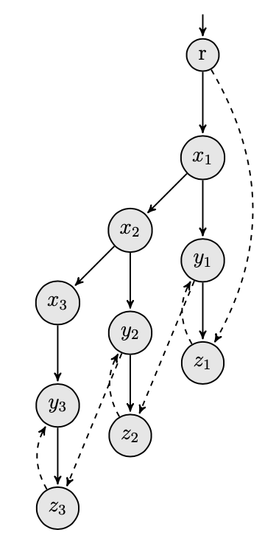
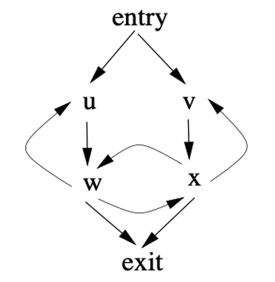
Examples of strange loops
Root
Root
R
Root
e₁₁
e₁₂
e₂₁
e₁₃
e₂₂
e₃₁
e₄₁
e₅₁
e₂₃
e₃₂
Return
e₅₂
e₃₃
e₄₃
e₅₃
Return
Return
e_{T}
T
The last two loops are from papers about difficulties of analyzing loops. We created the first loop as an example to use for this course.

Slide 7
What constraints do programming languages impose?
1
2
3
4
5
6
S
a
a1
a
a
a
a
continue
h
h
h
h
h
h
e3
e1
e
e
e
e
b
b
b
b
b
b
e2
continue
continue
a2
c
continue
c
e2
c
c
c
continue
c
e1
e3
d
d
d
d
RETURN
d
d
Note about #5: e2 must be the BREAK statement
continue
Which of the above loops allowed in C without using GO TO (jump) statements?
Ans. 1, 3, 4, 5

Slide 8
Abstraction of the programming language constraints
Unique Entry: A loop must have a unique entry which is also the exit from the loop.
Unique Successor of Entry: Entry has a unique successor outside the loop
Normal Path: A loop must have one or more normal paths – a normal path starts at the entry, and it can iterate
Exceptional Path: A loop can have one or more exceptional paths – an exceptional path has two parts: (a) prefix -that is prefix of one or more normal paths, (b) suffix that is not in a normal path, and the suffix always ends with either the unique successor of loop Entry or at the RETURN.
Unique Entry
Program before the loop
S: Unique Successor
Normal Paths:
HA, HB, HC
H
Exceptional Path:
prefix . suffix
concatenation
HY . YS
C
Y
Multiple paths are created by branch nodes
A
B

Slide 9
Violations of constraints
2
Unique Entry
1
Program before the loop
S: Unique Successor
S
a
H
a1
h
C
h
Y
e1
A
e
b
B
b
c
e2
continue
a2
c
d
e3
What constraints are violated in these examples?
d
continue

Slide 10
Control Path Model (CPM) for loops
Key points:
CPM is applicable to real-world software
CPM enables accurate but tractable analysis/verification of properties relevant to software vulnerabilities.
CPM leads to an efficient algorithm for estimating the number of execution paths in presence of loops
Note: On DARPA funded cybersecurity projects, the control path model was developed and used for analyzing thousands of loops for safety and security vulnerabilities.

Slide 11
How do we compute entry points and check if a loop has more than one entry point?
So far, the loop model is presented to provide an intuitive understanding. The intuitive description is not enough to write programs to construct loop models and check violation(s) of constraints.
The required definitions and algorithms were developed from fifties to seventies. Pioneers in the field include Frances Allen and Robert Tarjan.
Robert Tarjan Turing Award Speech (1986): https://www.youtube.com/watch?v=3t42E44d5aY
Frances Allen Turing Award Speech (2006): https://www.youtube.com/watch?v=NjoU-MjCws4
Prosser introduced the idea of dominator in his 1959 paper. Tarjan developed algorithms to compute dominators, and Allen applied them to optimize compilers. Here, we will use dominators to define and compute the loop entry.

Slide 12
Context: Loops with multiple entry points can be very difficult to analyze. Not being able to analyze loops is a serious problem for verifying safety and security of software.
How do we compute entry points and check if a loop has more than one entry point?
Programs written in high-level languages: There is a simple method to check if there are loops with multiple entry points.
Loops with multiple entry points
Program must have GO TO
Note: the converse is not true
A sophisticated method is necessary if the task is to analyze: (a) software such as Linux which has GO TO, (b) binary code.
As discussed in the Cybersecurity Arms Race lecture, without verifying sanctity of binary code the cybersecurity threat looms large.

Slide 13
What is a loop?
Imagine you are talking to your friend on phone. Both of you have the same graph in front of you. You see a loop in the graph, but your friend doesn’t see that loop. How will you help to your friend? You want him/her to understand what a loop is and its entry point.
I would like to hear your ideas in the next class.
Avoid getting readymade answers. You will learn more if you think about it.

